Slide 1
SmartEduTrack: WiFi-Based Student Attendance System
CSE7101- Capstone Project
Review-2
Batch Number: IST_4
Under the Supervision of,
Dr.Poornima S
Assistant Professor
School of Computer Science and Engineering
Presidency University
Roll Number | Student Name
20221IST0023 | G DHANUSH
20221IST0004 | ANOOP KUMAR
20221IST0006 | NAVYA B
Name of the Program: Information Science and Technology
Name of the HoD: Dr. Pallavi R
Name of the Program Project Coordinator: Ms. Benitha Christinal J , Dr. Afroz Pasha
Name of the School Project Coordinators: Dr. Sampath A K , Dr. Geetha A

Slide 2
Content
Abstract
Literature Survey
Objectives
Existing Methods and Drawbacks
Proposed Methods and Feasibility Study
Architecture Diagram
Modules
Hardware and Software Details
Timeline
References

Slide 3
Abstract
Background: Manual attendance is time-consuming and prone to errors.
Problem: Traditional biometric/RFID methods lack flexibility and scalability.
Proposed Solution: A smart WiFi-based system where student devices connect via SSID; Flask API validates MAC + Register No. and marks attendance automatically.
Outcome: Ensures accuracy, saves time, prevents proxy attendance.
Future Scope: Integration with Power BI for analytics and expansion to smart campuses.

Slide 4
Problem Statement
Issues with Existing Systems:
- Delays in manual marking
- Risk of proxy attendance
- Biometric/RFID require extra hardware
Gap: Need for low-cost, reliable, non-intrusive method.

Slide 5
Literature Survey
Paper 1 (IEEE, 2022): WiFi-based Presence Detection
Used MAC address authentication
Drawback: Can be spoofed easily
Paper 2 (IEEE, 2021): Smart Attendance via WiFi Fingerprinting
Used RSSI signal strength
Drawback: Accuracy reduced due to obstacles & distance
Paper 3 (IEEE, 2020): IoT-based Smart Classroom Management
Integrated WiFi + IoT devices
Drawback: Costly & complex setup
Paper 4 (IEEE, 2019): Mobile App Integrated WiFi Attendance
Combined WiFi SSID validation + Mobile app
Drawback: User dependency, battery issues
Paper 5 (IEEE, 2018): Cloud-Based Smart Attendance
Stored attendance in cloud servers
Drawback: Internet dependency, privacy concerns

Slide 6
Objectives
1. Automate attendance with minimal manual intervention.
2. Use existing WiFi infrastructure – no new hardware.
3. Enhance security using MAC addresses.
4. Provide mobile app interface for students.
5. Give faculty real-time reports & analytics
6. Multi-Parameter Validation
Validate SSID, MAC Address, and Registration Number to avoid spoofing.

Slide 7
Existing Methods & Drawbacks
Manual: Slow, error-prone
Biometric: Expensive, privacy issues
RFID: Risk of card sharing
QR Code: Proxy possible, time-consuming
Proposed WiFi-based system:
- Faster
- Low cost
- Secure
- Automated

Slide 8
Proposed Methodology
- Student App (Android, Kotlin): reads current Wi‑Fi SSID, sends check‑in with register number and device MAC.
- Backend (Flask): verifies session is active, SSID matches, and MAC equals the registered device for the student.
- Database (SQLite/SQLAlchemy): stores students, courses, sessions, attendance.
- Reports: per‑session CSV export.
- Security: faculty API key required for administrative actions.

Slide 9
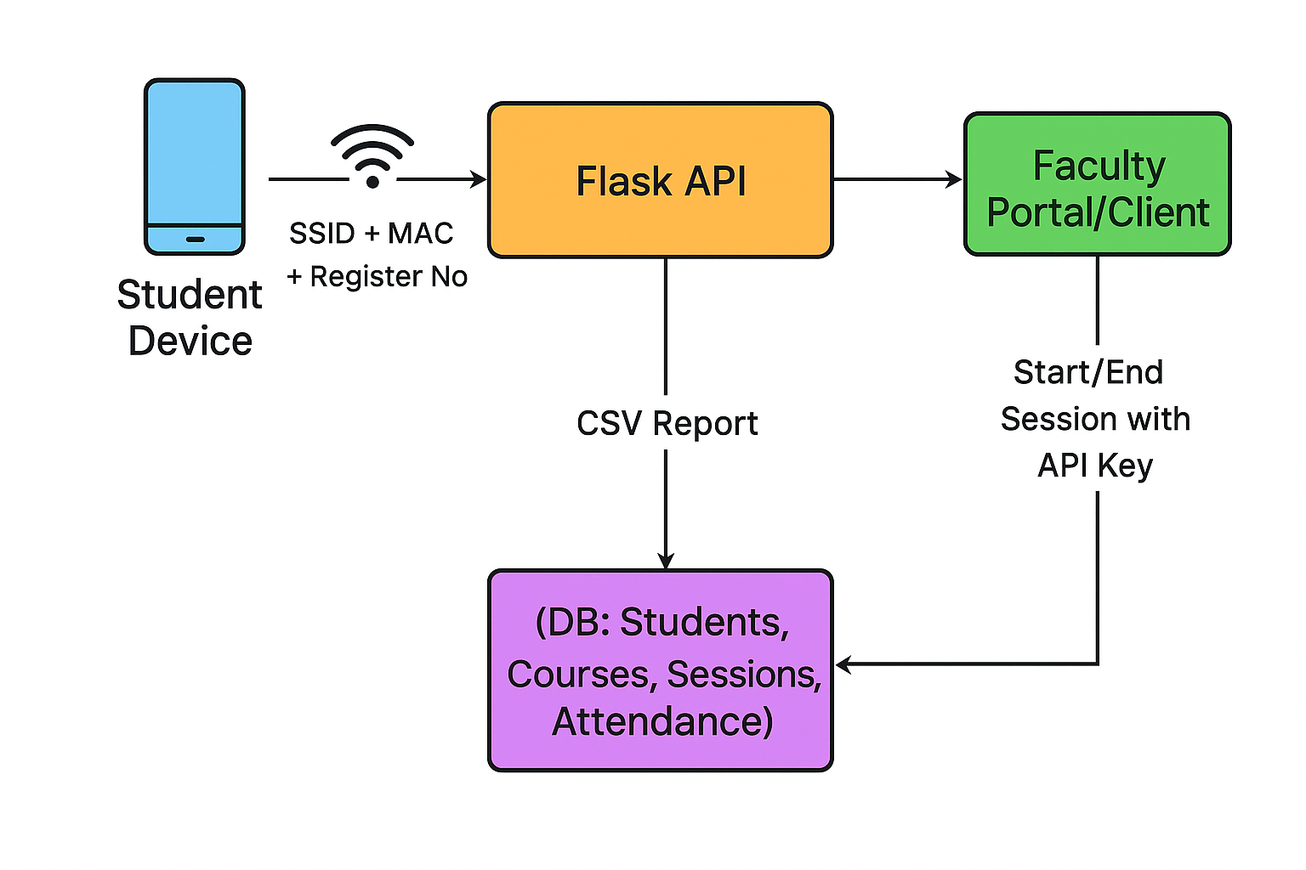
System Architecture

Slide 10
System Modules
Module | Description | Unique Feature
1. Student Device | Captures SSID, MAC Address, and Register No. from student’s smartphone while connected to classroom WiFi | Lightweight, no extra app installation required
2. Flask API | Acts as the backend service that validates input, starts/ends sessions, and interacts with the database | Multi-parameter validation (SSID + MAC + Reg No.)
3. Database | Stores structured records of Students, Courses, Sessions, and Attendance | Centralized, scalable storage ensuring data security
4. Faculty Portal | Allows faculty to start/end class sessions, view live attendance, and access data | Role-based access with API key authentication
5. Report Generator | Exports session-wise or course-wise attendance in CSV format | Easy record-keeping, compatible with external tools like Excel/Power BI

Slide 11
Hardware & Software Requirements
Hardware:
Processor: Intel i3/i5 or higher
RAM: Minimum 4 GB (8 GB recommended)
Storage: 250 GB HDD / SSD
WiFi Router: Standard 2.4/5 GHz router
Student Devices: Smartphones (Android/iOS with WiFi)
Faculty System: Laptop/Desktop with browser acce
Software:
Operating System: Windows 10/11 or Linux (Ubuntu)
Programming Language: Python 3.8+
Framework: Flask (Python Micro-framework)
Database: MySQL / MongoDB
Web Browser: Chrome / Firefox
IDE/Editor: VS Code / PyCharm
Reporting Tool: CSV/Excel or Power BI (optional for visualization)

Slide 12
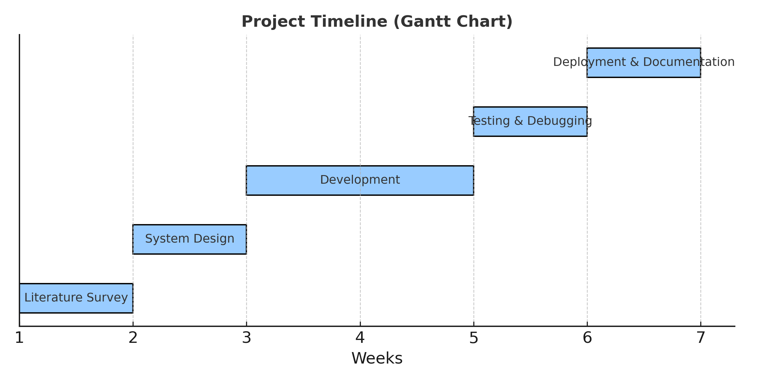
Project Timeline (Gantt Chart)

Slide 13
Advantages & Limitations
Advantages:
- Low cost
- Reduces manual errors
- Saves time
Limitations:
- Requires smartphones
- WiFi must be stable
- Security depends on MAC filtering

Slide 14
Future Scope
- AI-powered fraud detection
- Integration with university ERP
- Cloud-based scalability
- Blockchain for secure logs
- Cross-platform apps (Android & iOS)
- Agentic AI

Slide 15
References of IEEE papers
[1] D. Takahashi et al., 'IEEE 802.11 user fingerprinting and applications,' IEEE, 2021.
[2] J. Zheng, K. Li, and X. Zhang, 'Wi-Fi fingerprint-based indoor localization,' Sensors, 2022.
[3] F. Wang et al., 'Joint Activity Recognition and Indoor Localization with WiFi,' arXiv, 2021.
[4] C. M. Mesa-Cantillo et al., 'Non-Intrusive Human Presence Detection via WiFi CSI,' IEEE, 2020.
[5] M. Choi et al., 'Attendance Check System and Implementation for Wi-Fi,' IEEE, 2019.
[6] IJIREEICE, 'Attendance Monitoring System Utilizing Wi-Fi,' 2018.
[7] ResearchGate, 'Wi-Fi Based Smart Attendance Monitoring System,' 2021.
[8] J. Infotel, 'Revolutionizing Attendance Using ESP-NOW,' J. Infotel, 2024.
[9] M. Rahaman, 'SmartPresence: Wi-Fi-based attendance,' Springer, 2025.
[10] S. He et al., 'Wi-Fi Fingerprint-Based Indoor Positioning: A Survey,' IEEE, 2019.

Slide 16


